Slide 1
Managing Uncertainty in Sensor Databases
Reynold Cheng & Sunil Prabhakar
Department of Computer Science, Purdue University
SIGMOD Record, 2003

Slide 2
Outline
Motivation
  Why Managing Uncertainty in Sensor Databases?
A Taxonomy of Data Uncertainty Model
Approaches: How to Managing Uncertainty in Sensor Databases?
  Interval Query
  Probabilistic Threshold Query
  Optimization
Comparison and Conclusion

Slide 3
Outline
Motivation
  Why Managing Uncertainty in Sensor Databases?
A Taxonomy of Data Uncertainty Model
Approaches: How to Managing Uncertainty in Sensor Databases?
  Interval Query
  Probabilistic Threshold Query
  Optimization
Comparison and Conclusion

Slide 4
What Is Uncertainty (In Sensor Databases)?
Ball ?
In daily life:
In Sensor Databases:
moon ?
coin ?
wheel ?
others?
O1
O
O2
10:00
A
M
B
O1
O
O2
10:05
A
C
M
B
D
TIME | O1.POSITION | O2.POSITION | O.POSITION
10:00 | A (0) | B (12) | M (10)
10:05 | C (8) | D(20) | M (10)
… | … | … | …
Which one is the Nearest-Neighbor to O, O1 or O2?

Slide 5
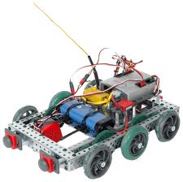
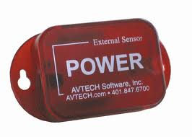
Why Is There Such Uncertainty?
Main reason
  To monitor continuously changing entities (e.g., locations of moving objects and temperature), therefore, continuous changes in these values.
Other impact factors
  Limited resources (e.g., network bandwidth and battery power)
Plan cannot keep up with changes !

Slide 6
Motivation
Why managing uncertainty in Sensor Databases?
  If we don’t ……
    Query at 10:[00+5n]
    Query between 10:[00+5n] and 10:[00+5(n+1)]
Doubtless, we need manage uncertainty for the purpose of acquiring correct answers.
O1
O
O2
10:00
A
M
B
O1
O
O2
10:05
A
C
M
B
D

Slide 7
Outline
Motivation
  Why Managing Uncertainty in Sensor Databases?
A Taxonomy of Data Uncertainty Model
Approaches: How to Managing Uncertainty in Sensor Databases?
  Interval Query
  Probabilistic Threshold Query
  Optimization
Comparison and Conclusion

Slide 8
A Taxonomy of Data Uncertainty Model
Three types of data uncertainty
  Point uncertainty
  Interval uncertainty
  Probabilistic uncertainty
Point uncertainty
  Each data item is assumed to be a correct representation of the external entity being monitored.
  Inputs of query: the values of T_{i}.a
  Outputs of query: maybe an incorrect answer
O1
O
O2
10:00
A
M
B
O1
O
O2
10:05
A
C
M
B
D

Slide 9
A Taxonomy of Data Uncertainty Model
Interval uncertainty
  Using an interval to bound the possible values of T_{i}.a
  Uncertainty interval: U_{i}(t) is an interval [l_{i}(t), u_{i}(t)], T_{i}.a∈[l_{i}(t), u_{i}(t)]
  Inputs of query: T_{i}.a, U_{i}(t)
  Outputs of query: maybe certain or uncertain
Interval of O1
Interval of O2
O1
O
O2
10:00
A
M
B
O1
O
O2
10:05
A
C
M
B
D
Certain answer

Slide 10
A Taxonomy of Data Uncertainty Model
Probabilistic uncertainty
  Probability density function (pdf): f_{i}(x,t) is a pdf of T_{i}.a, such that f_{i}(x,t)=0 if x ∈ U_{i}(t))
  Inputs of query: T_{i}.a, U_{i}(t), f_{i}(x,t)
  Outputs of query: objects with probability.
    E.g., {(O1,30%),(O2,50%)}
Interval of O1
Interval of O2
O1
O
O2
10:00
A
M
B
O1
O
O2
10:05
A
C
M
B
D
Uncertain answer

Slide 11
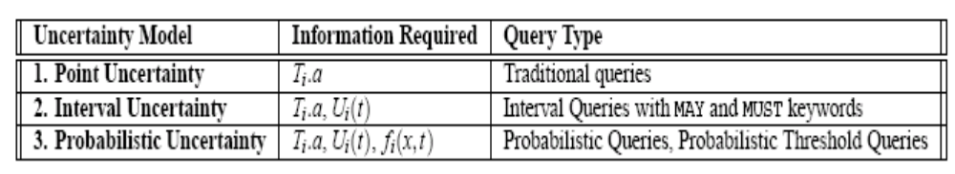
What Can We Do Using Uncertainty Model?
Focus of this paper
  Querying rather than storing, fetching, updating or others
Overview of uncertainty model and query types
The most original strategy
Other people’s outcome[11]
Previous paper’s contributions[2]
This paper’s contributions

Slide 12
Outline
Motivation
  Why Managing Uncertainty in Sensor Databases?
A Taxonomy of Data Uncertainty Model
Approaches: How to Managing Uncertainty in Sensor Databases?
  Interval Query
  Probabilistic Threshold Query
  Optimization
Comparison and Conclusion

Slide 13
Interval Queries
What is Interval Query?[11]
  queries data with keyword MAY or MUST under the interval uncertainty model, and returns a set R of answers. MAY and MUST keyword is used to control the behavior of interval queries.
O1
Interval of O1
O
O2
Interval of O2
MAY: {O2}
10:00
A
M
B
O1
O
O2
MUST: {O2}
10:05
A
C
M
B
D
O1
Interval of O1
O
O2
Interval of O2
MAY: {O1,O2}
10:00
A
M
B
O1
O
O2
MUST: {NULL}
10:05
A
C
M
B
D

Slide 14
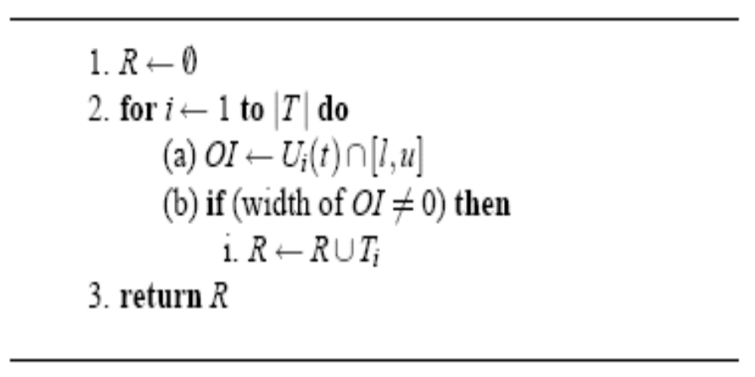

Interval Queries
Evaluating an Interval Range Query (IRQ)
  What is IRQ for uncertainty intervals?
    Inputs: T_{i}.a, U_{i}(t), range=[l, u]
    Outputs:
      All objects that hold that U_{i}(t)∩[l, u] ≠NULL, using MAY keyword query
      All objects that hold that U_{i}(t) is a subset of [l, u], using MUST keyword query
  Algorithm
……………………...
…………..……….
IRQ using MAY keyword
IRQ using MUST keyword

Slide 15
Interval Queries
Example for IRQ
RANGE: [l, u]
O1
Interval of O1
O2
Interval of O2
MAY: {O2}
10:00
A
B
RANGE: [l, u]
O1
O2
MUST: {NULL}
10:05
A
C
B
D
RANGE: [l, u]
O1
Interval of O1
O2
Interval of O2
MAY: {O1,O2}
10:00
A
B
RANGE: [l, u]
O1
O2
MUST: {NULL}
10:05
A
C
B
D

Slide 16
Which Answer Is More Convincible FOR IRQ?
RANGE: [l, u]
O1
Interval of O1
O2
Interval of O2
10:00
A
B
We have Range: [l, u], Interval of O1 and O2
Execute IRQ using MAY keyword
Return a result set: {O1, O2}
O1 is better than O2, or otherwise?
They don’t know
We need more quantified strategy……

Slide 17
Outline
Motivation
  Why Managing Uncertainty in Sensor Databases?
A Taxonomy of Data Uncertainty Model
Approaches: How to Managing Uncertainty in Sensor Databases?
  Interval Query
  Probabilistic Threshold Query
  Optimization
Comparison and Conclusion

Slide 18
Probabilistic Threshold Queries
What is PTQ?
  queries data with threshold p (where 0<p<1) under the probabilistic uncertainty model, and returns a set R of answers such that for each answer r ∈ R, r has a probability of p or more.
  Example
    if p=80%, the return result of certain PQ is {(O1,80%), (O2, 30%),(O3,10%),(O4,90%)}, then the result of PTQ is {O1,O4}.
Evaluating a Probabilistic Threshold Range Query (PTRQ)
  What Is PTRQ?
    Inputs: T_{i}.a, U_{i}(t), f_{i}(x,t), threshold p, range
    Outputs: objects (the probability of presenting in designate range is equal to or greater than p)
  PQ, PTQ : abstract
  PRQ, PTRQ: material
PRQ
+
Threshold: p
PTRQ

Slide 19
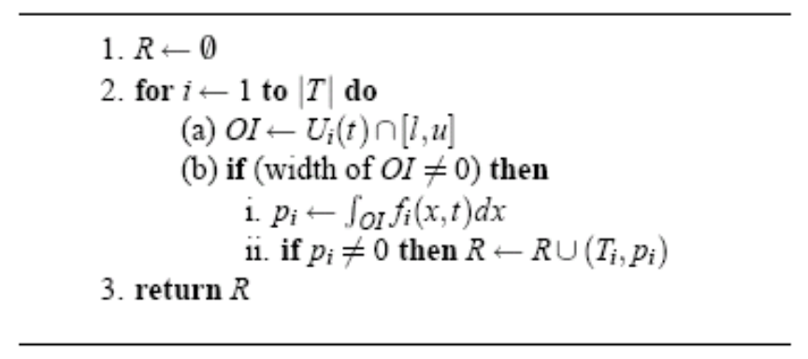
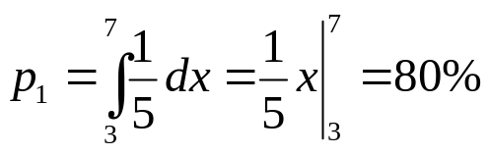
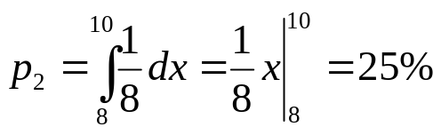
Probabilistic Threshold Queries
  Algorithm:
  Example for PTRQ:
    T₁.a=4, U₁(10)=[2, 7], f₁(x,10)=1/(7-2);
    T₂.a=12, U₂(10)=[8, 16], f₂(x,10)=1/(16-8);
PRQ
…………..……….
PTRQ
…………..……….
Interval of O1
RANGE: [3, 10]
O1
O2
Interval of O2
10:00
0
A
5
10
B
15
R={O1}

Slide 20
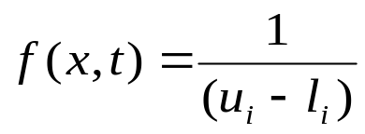
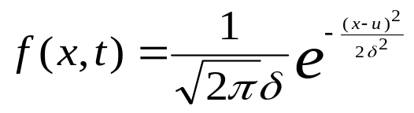
Is It Perfect?
Replace the pdf
Evaluating integrals
Augmenting objects: From {O1,O2} to {O1,O2,……,O_{n}}
2/5
2/5
1/5
1/5
5
5
(x1,y1)
(x2,Y2)
2/5
1/5
S1=Step*[(y2+y1)/2]
5
step
The efficiency of evaluating PTRQ dramatically drop down !!!

Slide 21
Outline
Motivation
  Why Managing Uncertainty in Sensor Databases?
A Taxonomy of Data Uncertainty Model
Approaches: How to Managing Uncertainty in Sensor Databases?
  Interval Query
  Probabilistic Threshold Query
  Optimization
Comparison and Conclusion

Slide 22
Optimization
General ideas
  Regulation 1: Estimate the upper bound of the integral (i.e., p_{i}) before evaluating it. If the upper bound smaller than the threshold p, then immediately conclude that p_{i} <p and O_{i} is not the answer.
  Regulation 2: Judge if M(=U_{i}(t)-OI) has a much shorter length than OI before evaluating the integral, if true, we can evaluate the M segment’s integral, if the value smaller than threshold p, then O_{i} is the answer.
  Regulation 3: When evaluating the integral, immediately stop computing if p_{i}>=p, we can conclude that O_{i} is the answer.
Example
2/5
(x6,Y6)
Regulation 1:
1/5
Estimate the upper of p_{i}: y6*(7-6)<<60%, then O_{i} is not the answer.
(x7,Y7)
P=60%
U_{i}(t)=[2,7]
Range=[6,8]

Slide 23
Optimization
Example (continue)
Range=[2, 6]
Regulation 2:
2/5
(x6,Y6)
(x1,Y1)
Judge if M=(U_{i}(t)-OI) much shorter than OI:5-4<<4, then evaluate M segment’s integral, obviously, the value < 60%, then O_{i} is an answer.
1/5
(x7,Y7)
P=60%
U_{i}(t)=[2,7]
Range=[3, 6]
p_{inter}(4)
2/5
Regulation 3:
p_{inter}(1)
P_{i}=p_{i}+p_{inter}(j)
1/5
Judge if pi>=p, if ture, stop computing, and then O_{i} is an answer.
P=60%
U_{i}(t)=[2,7]

Slide 24
Outline
Motivation
  Why Managing Uncertainty in Sensor Databases?
A Taxonomy of Data Uncertainty Model
Approaches: How to Managing Uncertainty in Sensor Databases?
  Interval Query
  Probabilistic Threshold Query
  Optimization
Comparison and Conclusion

Slide 25
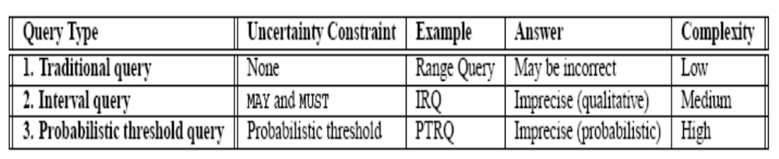
Comparison and Conclusion
A comparison of imprecise queries
Conclusion
  Uncertainty is inherent with constantly-changing sensor data. Therefore, For the sake of avoiding incorrect answers, its uncertainty should be considered when we execute query.
  Interval query is more efficient than traditional query, however, it cannot point out which one is the most convincible when there are more than one in the set of answers. Probabilistic query can handle the above problem, however its cost is considerable.
quantitative

Slide 26
Comparison and Conclusion
Conclusion (continue)
  PTQ is more efficient than probabilistic query because probabilistic threshold is exploited. More fortunate, PTQ are welcomed and can achieve the desire goals in many occasions.
  Optimization to PTQ can further improve the performance, we cannot ignore this point especially for processing sensor data.

Slide 27
Comparison and Conclusion
  THANKS

